Slide 1
AI & MACHINE Learning
Regression ( Linear, tree and random forest)

Slide 2
ASSIGNMENT
Gunakan dataset student score
Lakukan proses Exploratory data analysis
Lakukan feature engineering :
Check Duplicated Data
Check Missing Value Handling
Outlier Analysis
Lakukan modelling machine learning regression : gunakan minimal 2 model (linear regression, decision tree regressor, atau random forest regressor)
Lakukan evaluasi model
Berikan kesimpulan model mana yang terbaik performanya

Slide 3
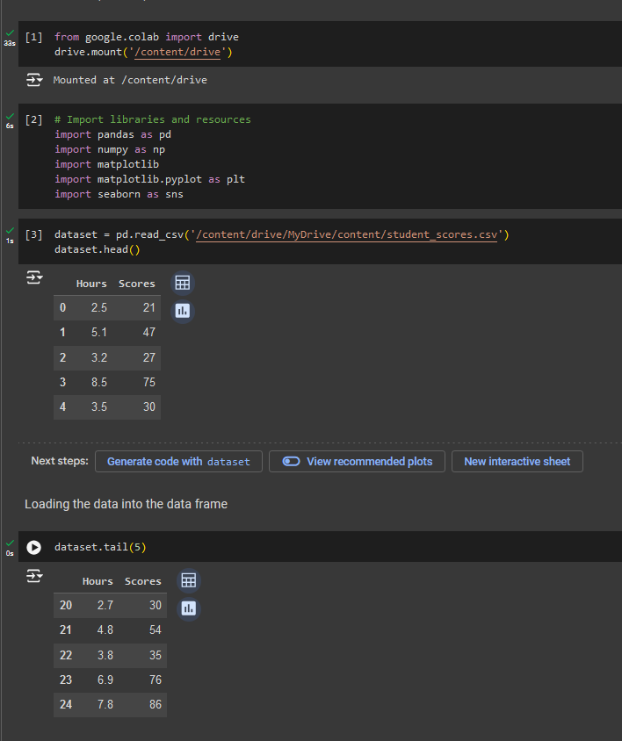
DATA PREPARATION
CONNECT THE DATA
Using data inside the GDrive called : student_scores.csv
Connect the google colab into t he GDrive.
Import all related libraries and resource.
Set the data as “dataset”
Then configure the head and tail of the data from the dataset to check the data availability.

Slide 4
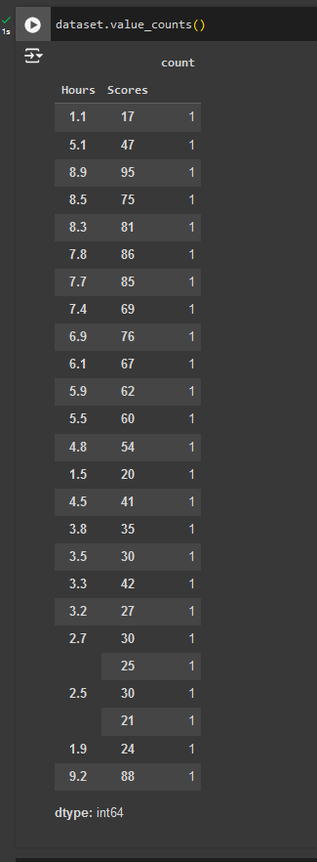
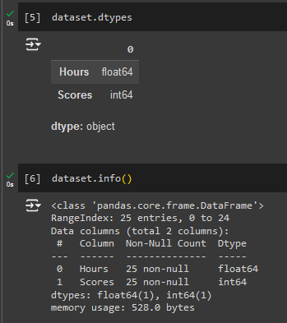
Data information details
Must know what the data type being used in our data
And we need to show the data info to decide the next step once the data info is correct
The next step is to count the dataset values, it means counting the duplicated values in our data.

Slide 5
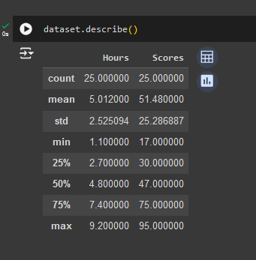
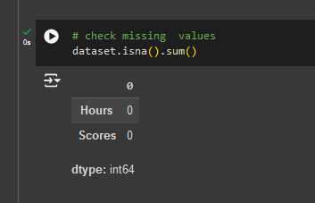
DATA DESCRIBTION and missing values

Slide 6
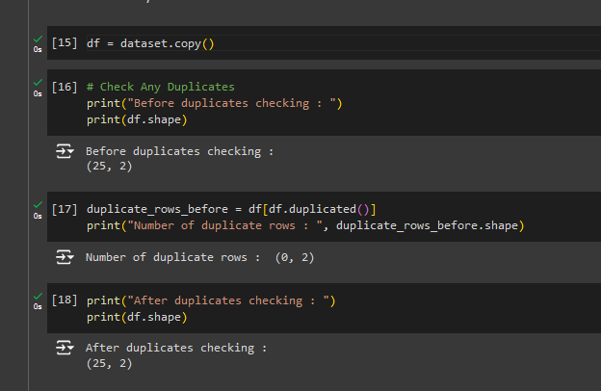
Checking duplicated data

Slide 7
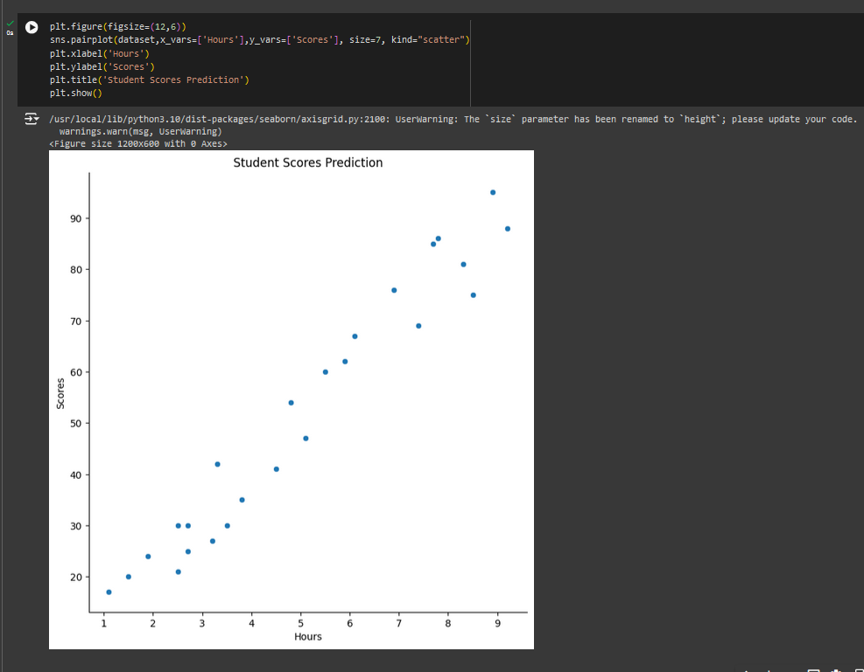
Data analysis using scatter

Slide 8
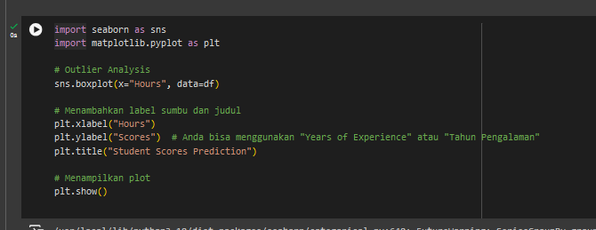
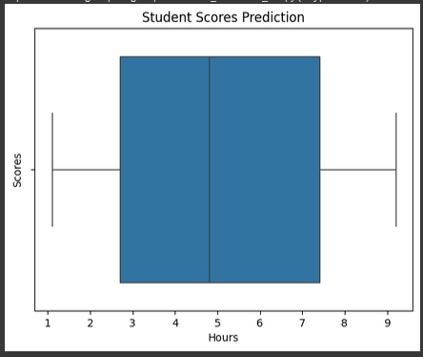
Plotting data into seaborn

Slide 9
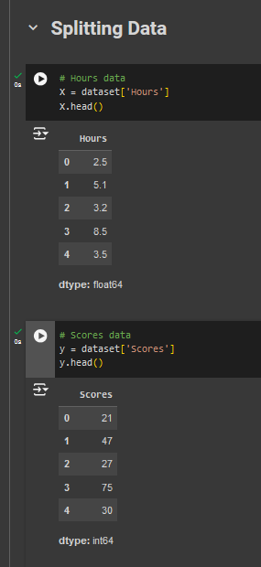
Data splitting

Slide 10
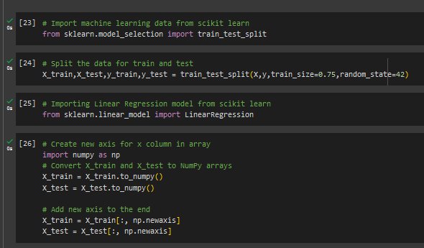
Machine learning analysis

Slide 11
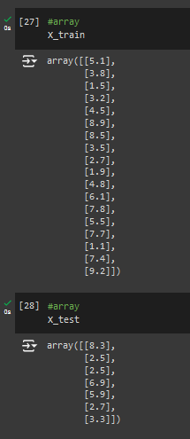
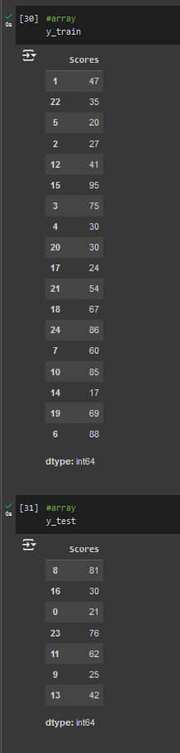
Data train and test on X and Y axis

Slide 12
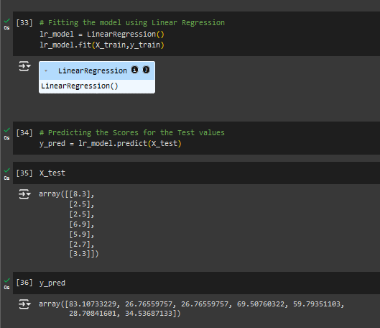
Linear regression
Showing the regression mode
Derive the y prediction

Slide 13
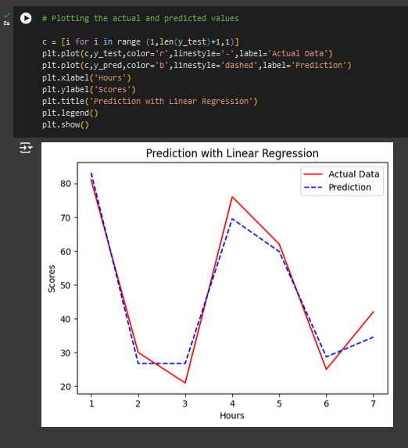
Plotting the prediction on line chart

Slide 14
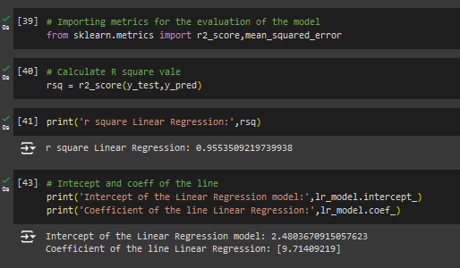
Data conclusion
Evaluate the model
Find the r square
Then print the r square for linear regression value
Print the regression coefficient

Slide 15
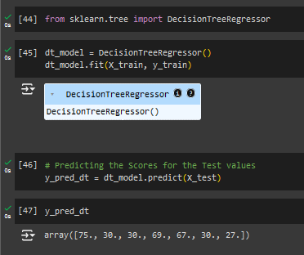
Decision tree
Shows the next regression mode
Find the y prediction for decision tree

Slide 16
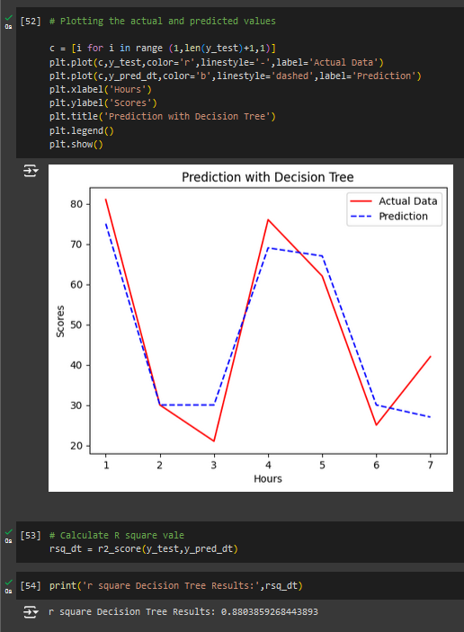
PLOT the prediction for decision tree

Slide 17
r square value of the decision tree

Slide 18
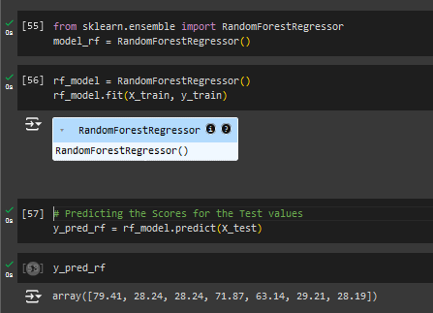
Random forest
Shows the next regression mode
Find the y prediction for random forest

Slide 19
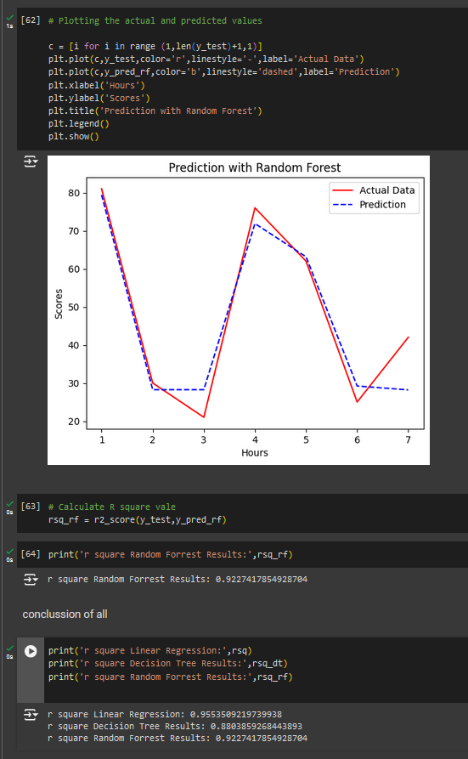
Plot the random forest prediction

Slide 20
The r square value of random forest

Slide 21
Overall conclusion
The most efficient method is the Linear regression for this type of data as we know the values is nearly 1.0

